Slide 1

FARM MANAGEMENT INFORMATION SYSTEM (FMIS)
The Changing Face of Digital Agriculture
FYDP - II

Slide 2
CONTRIBUTORS:
RAFSAN JANI RATUL - 011161113
HIMEL MAZUMDER - 011161045
SALMAN IBN ARSHAD - 011162131
KAZI FARIHA FERDOWS - 011153060
Group A7, CSE 4000B
Course Teacher:
Dr. Md. Motaharul Islam
Professor, Dept. Of CSE, UIU
Supervisor:
Mr. Suman Ahmmed
Assistant Professor, Dept. Of CSE, UIU

Slide 3

Presentation Outline
Problem Statement
Motivation
Objectives
Methodologies
Background
Benchmark Study
GAP Analysis
Project Design
Project Limitations
Conclusion

Slide 4
Introduction
Problem Statement
Why it is Necessity ?
Problems solved by FMIS

Slide 5
Motivation
Reduce workloads, costs
Increase production
Make management easier
Introducing technologies to the farming sector
Cost reduction and improved efficiency

Slide 6

Objectives
Wider Marketplace
Knowledge sharing
Safe and healthy food
Marketplace for farming tools and seeds

Slide 7
Methodologies
Methodologies
Analysis
Current state of farming
Analysis
Existing Systems
Literatures
Design
Design
Implementation
UI/UX
Coding
Testing
Implementation
UML

Slide 8
Background
Literature review
Journal name: Precision Agriculture
Article title: Reference Architecture Design for Farm Management Information System: A multi-case study approach by J.Tummers, A.Kassahun, B.Tekinerdogan (Impact factor: 4.454)
Our findings:
Number of identified stakeholders and their concerns (Context View) for FMIS
List of possible features and sub features from feature model (Decomposition view)
Methods to derive an application architecture
Current reference architectures of FMIS

Slide 9
Background
Related research
Journal title:
Computer and Electronics in Agriculture
Article title: Obstacles and features of Farm Management Information Systems: A systematic literature review.
Our findings:
Definition and characteristics of MIS and FMIS
Obstacles for development of FMIS
Features of FMIS
Various FMIS related statistics

Slide 10
Background
Related research
Journal title:
Computer and Electronics in Agriculture
Article title: Conceptual model of a future farm management information system
Our findings:
Definition of MIS and FMIS
Current situation and difficulties of Farm management

Slide 11
Background
Related research
Journal title:
Computer and Electronics in Agriculture
Article title: Farm management information systems: Current situation and future perspectives
Our findings:
Concept of different domains of farming such as finance, inventory, traceability, reporting etc
Concept of MIS with respect to farm operation management
Review of some commercial FMIS

Slide 12
Background
Similar Application
Agrivi (www.agrivi.com):
Some features of Agrivi:
a. Management of activities such as finance, inventory, workforce, resource etc.
b. Analytics to monitor farm performance.
c. Weather monitoring and pest detection.

Slide 13
Background
Similar Application
Granular (granular.ag):
Some features of Granular:
a. Pinpoint and fix production issues.
b. 3-m satellite imagery
c .Analyze profits
d. Control inputs and inventory
e. Crop and field planning
f. Mobile access

Slide 14

GAP Analysis
UI/UX
Local Language Support
Unit Converter Support
Glossary Support

Slide 15

Agricultural marketplace and blog platforms
CivilEats.com - Independent, nonprofit digital news and commentary site about food system
ModernFarmer.com - Modern Farmer is a site devoted to agriculture and food
AgriFarming.in - Site about information related to agriculture farming information, project reports and case studies

Slide 16

Agricultural marketplace and blog platforms
dtnpf.com - site for a an agricultural magazine named progressive farmer, published 14 times a year by DTN
iFarmer.asia - A Bangladesh based platform. A technology company helping small-scale farmers and Agri Businesses to maximize their profit.

Slide 17
Benchmark Study based
on some similar platforms
Platform | News & Blog | Shop | Marketplace | Tech & Financial Support
CivilEats.com | Yes | No | No | No
ModernFarmer.com | Yes | Yes | No | No
AgriFarming.in | Yes | No | No | No
dtnpf.com | Yes | No | Yes | Yes
iFarmer.asia | No | No | Yes | Yes
Atai-Research.org | No | No | Yes | Yes

Slide 18
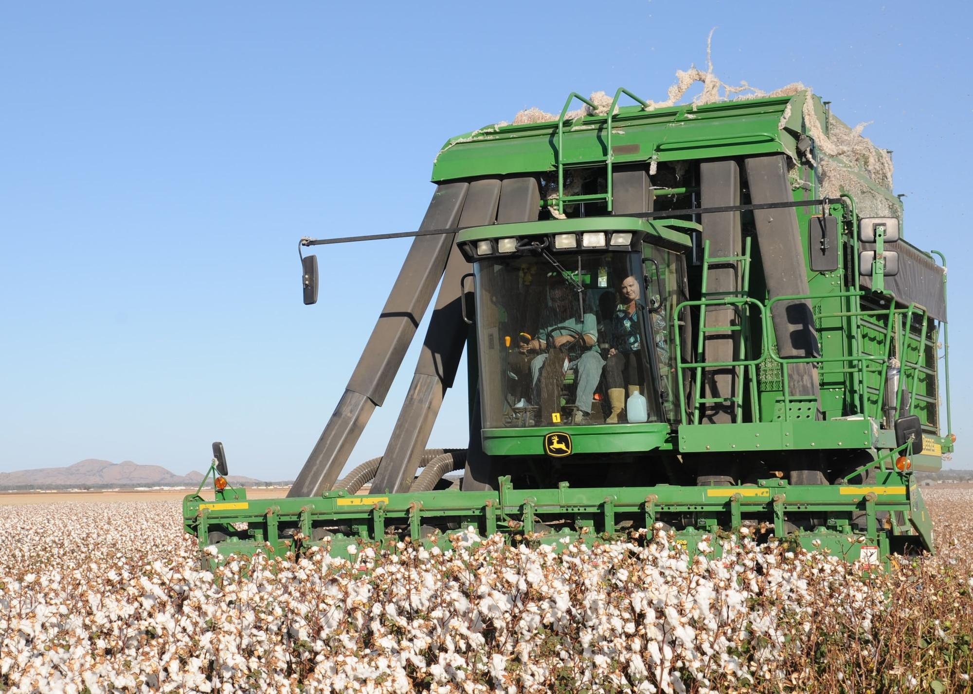
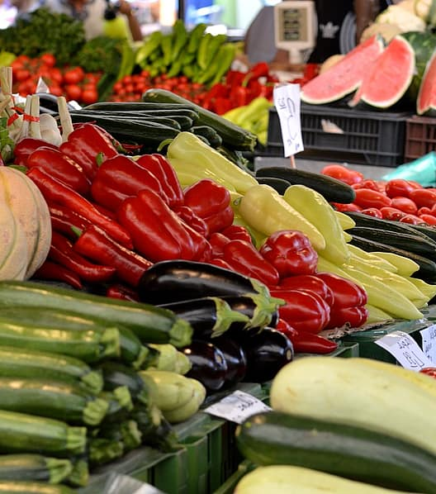
Feature Implementation
Our Features
Article and Blog
Farm product Marketplace
Farm Equipment and Seeds Marketplace

Slide 19
Main Concept
Website on Agricultural Blog and Marketplace
Three types of Main Users.
a. Farmer b. Consumer c. Contractor
Farmers will post about their farm products
Consumers will buy from farmers
Contractors will sell equipments and seeds to farmers
Tips and tricks related to farming and farm products will also be there.

Slide 20
Project Design
Functional Requirements
Non-Functional Requirements
Log in, Log out & Registration with Email Verification
Account Type and Account Dashboard
Posting, Post Format & Post Sorting
Post Comment
Post Rating, Reporting and Bookmarking
Post Updating and Removing
Admin Control
Account Removal
Security
Localization
Usability
Capacity
Compatibility

Slide 21
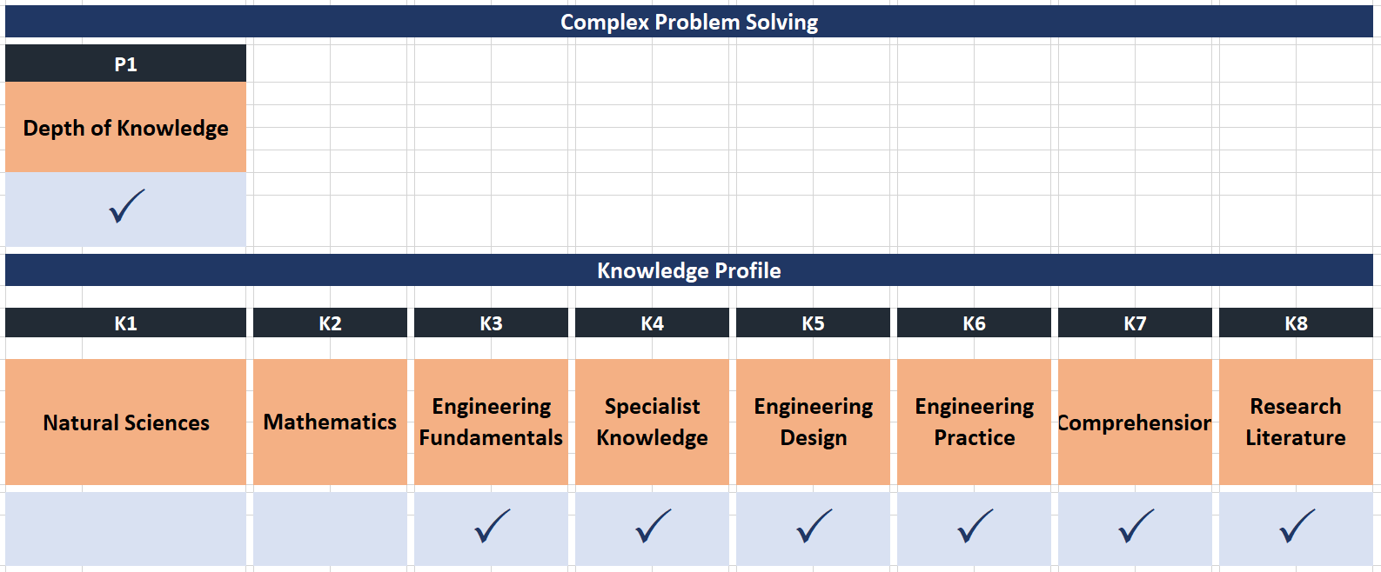
Complex Engineering Problem
‹#›

Slide 22
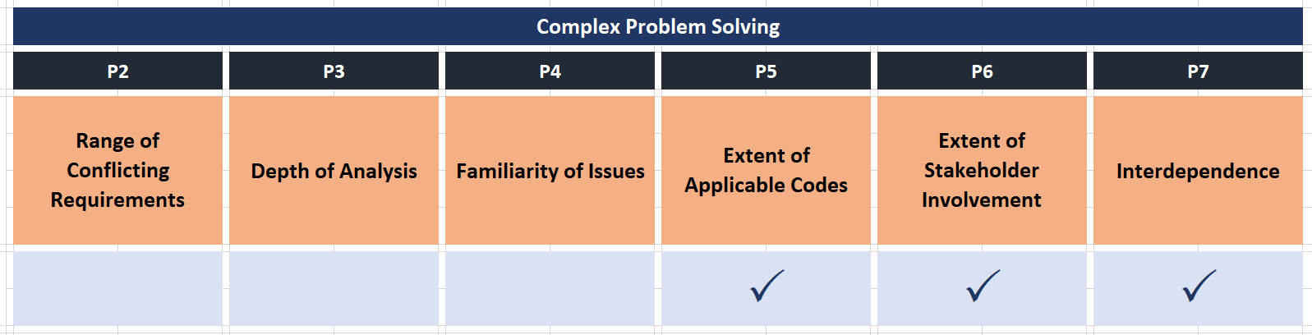
Complex Engineering Problem
‹#›

Slide 23
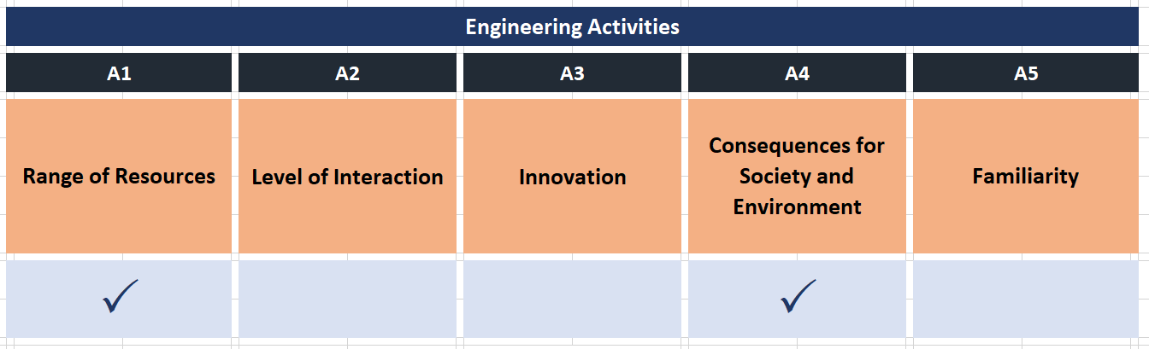
Engineering Activities
‹#›

Slide 24
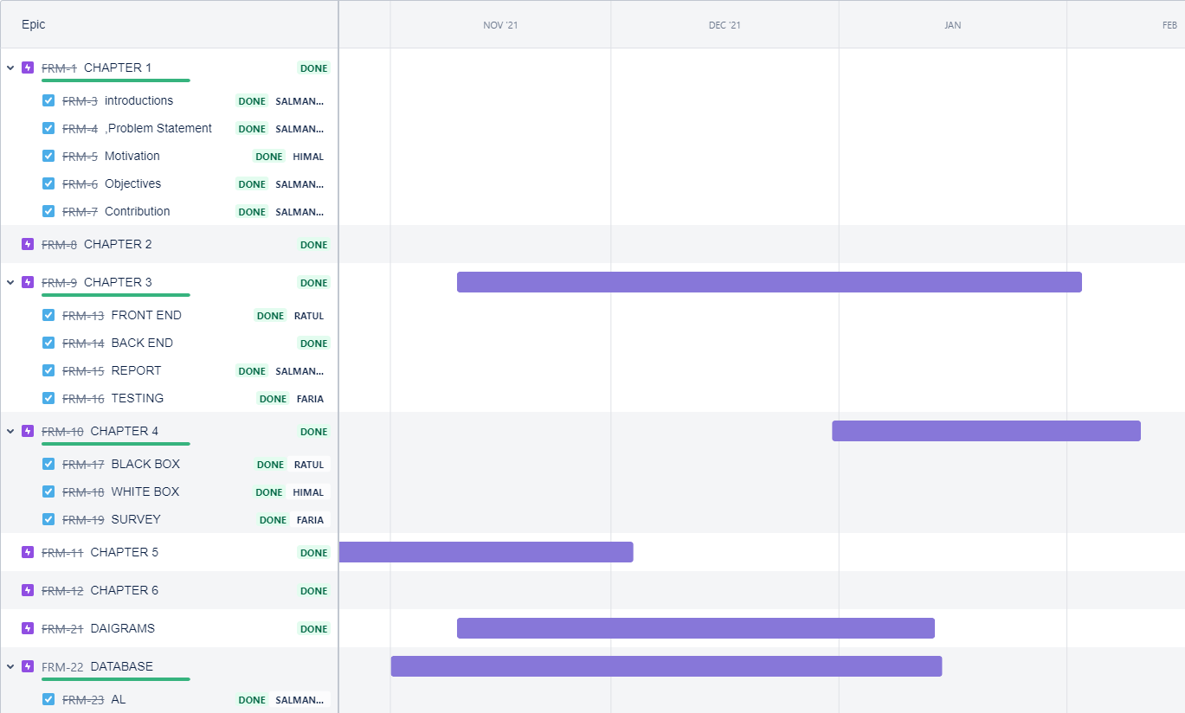
Project Management
Project Plan and Task Allocation:
JIRA -
An agile Project Management Tool

Slide 25

Environment &
Implementation Tool
Development:
Front End:
HTML, CSS, JavaScript
Front End Framework:
Bootstrap and React JS

Slide 26

Environment &
Implementation Tool
Development:
Back End:
JavaScript
Back End Framework:
Node JS

Slide 27

Environment &
Implementation Tool
Database and Others:
Database:
MongoDB & Firebase
Design Guideline:
Material UI
Design Tool:
Figma

Slide 28

Environment &
Implementation Tool
Server OS
Cloud Linux (Shared Hosting)
Integrated Development Environment
VS Code
WebStrom

Slide 29
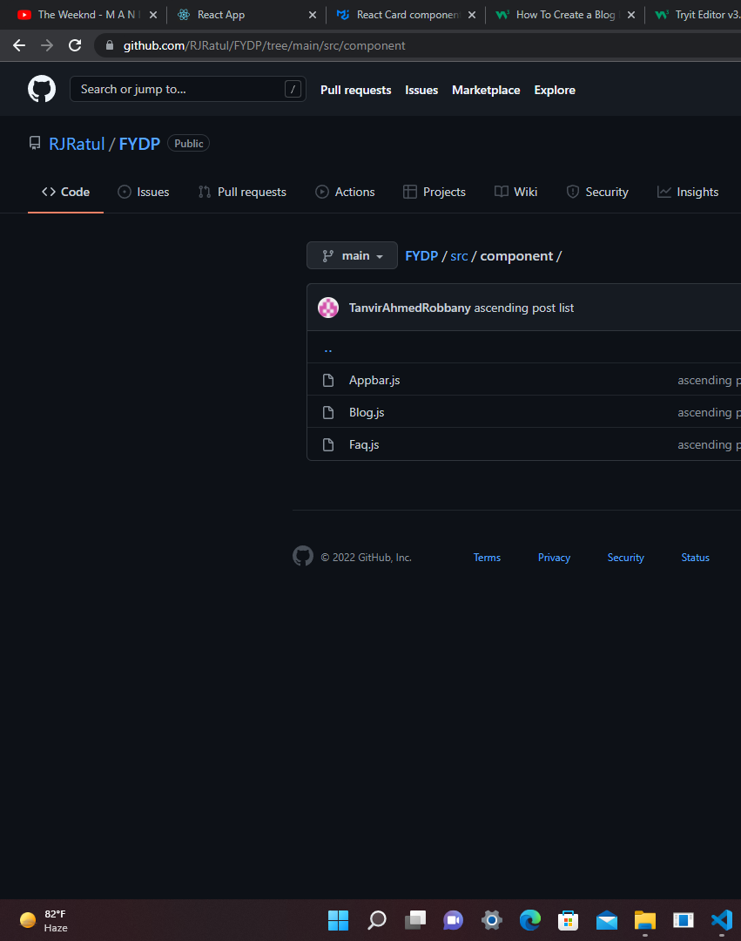
Environment &
Implementation Tool
Version Control
System: Git
Repository management tool: GitHub

Slide 30
Project Testing
Unit
Testing
Back End & Front End method input and output
Integration
Testing
Integration among system modules
Functionality Testing
Link Testing
Form Testing

Slide 31
Project Limitations
Own Delivery System
Such system requires having complex establishments
Fraud Detection
Fraud Detection prior to any reported case is not possible
Post Reporting
Benign posts might be reported as malign due to lack of verification by the expert of the concerned subject

Slide 32
Conclusion
Future Work
Implement Corpus Analysis to collect 'real-life' language samples.
Make a mobile application.

Slide 33
References
Reference architecture design for farm management information systems: a multi-case study approach
Architecture design approach for IoT-based farm management information systems
Smart Contract-Based Agricultural Food Supply Chain Traceability
Growing Plants, Raising Animals, and Feeding Communities through Connected Agriculture: An IoT Challenge
Ontologies and Artificial Intelligence
Systems for the Cooperative Smart Farming Ecosystem
internet-of-Things (IoT)-Based Smart Agriculture: Toward Making the Fields Talk
A Multi-Modal Approach for Crop Health Mapping Using Low Altitude Remote Sensing, Internet of Things (IoT) and Machine Learning

Slide 34
Q&A
THANK YOU

